Slide 1
Days of the week
Учитель английского языка: Рябчиков П.А.

Slide 2
Like
I like to sing a song.
He likes to sit at home.
She likes to go to school.
It likes to be so cool.
You like to play a game.
They like to say his name.
We like to ride a bike.
I like this poem “Like”.

Slide 3
Sunday
Воскресенье
Monday
Понедельник
Tuesday
Вторник
Wednesday
Среда
Thursday
Четверг
Friday
Пятница
Saturday
Суббота

Slide 4
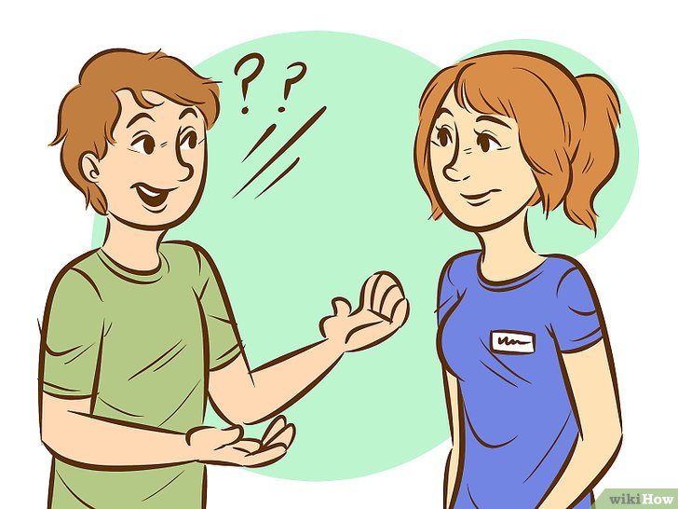
What is your favorite day of the week?
My favorite day is … .
I like to … on … .

Slide 5
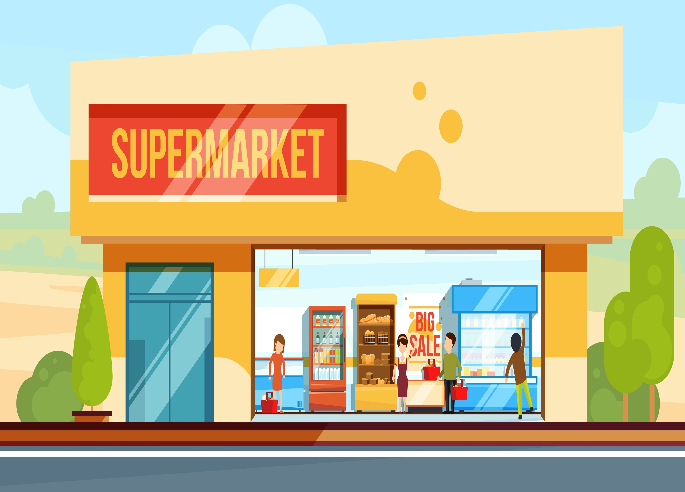
Shop “Funny Day”
Sunday – closed
Monday – closed
Tuesday – closed
Wednesday – closed
Thursday - closed
Friday – open
Saturday - closed

Slide 6
Thank you!

Slide 7
Ресурсы
Картинки:
https://ru.wikihow.com/принимать-решения
https://rock-cafe.info/suggest/supermarket-cartoon-pics-73757065726d61726b6574.html
Песня:
http://englishearly.ru/pesnya-pro-dni-nedeli/

